Slide 1

Tidying Data
ICPMS Data Analysis
Notes:
Image Credit: https://twitter.com/allison_horst/media

Slide 2
Today’s Goals:
Tidy Data
Learn:
What is it?
How is it useful?
Apply:
Tidy ICPMS Data in R
Function Writing
Learn:
What are the basic principles of writing a function
How to read a function
Apply (Optional):
Use function writing to simplify
ICPMS data analysis

Slide 3
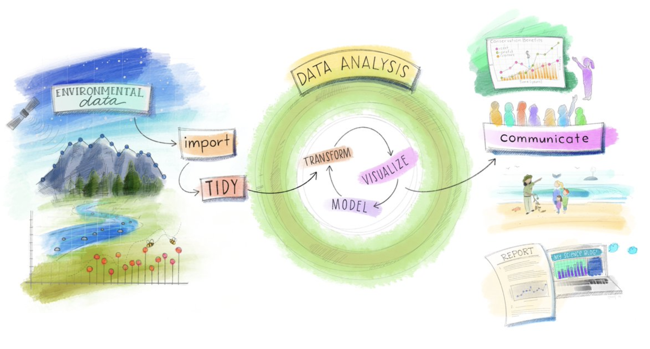
On Moodle:
Chem311_Soil_Lab.zip
Tidying Data Presentation
Notes:
Image source: https://twitter.com/allison_horst/media

Slide 4
Disclaimer!!
Notes:
Not everyone codes the same way in R, and there is no one “correct way” to code. These are just some rules and skills I learned while reading a bunch of R literature on the applications of coding in R. My hope is that by learning some of the “rules” to coding in R we can code more efficiently with less error messages, this may very well not be the case!!

Slide 5
What is “Tidy Data”?
Tidy refers to data that follows a set of formatting rules in order to simplify data analysis.
Notes:
Tidy Data is a type of data format that follows a set of rules and helps simplify data analysis in R. It is especially helpful when working with medium to large data sets such as the ICPMS data.

Slide 6
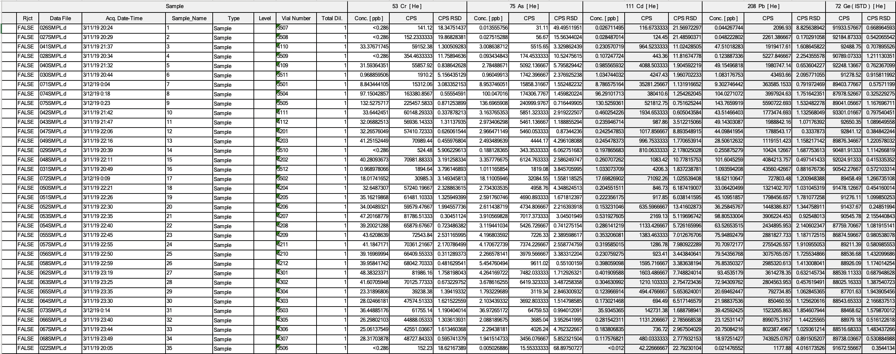
What is “Tidy Data”?
Notes:
This is what the OHSU data looks like prior to tidying in R.

Slide 7
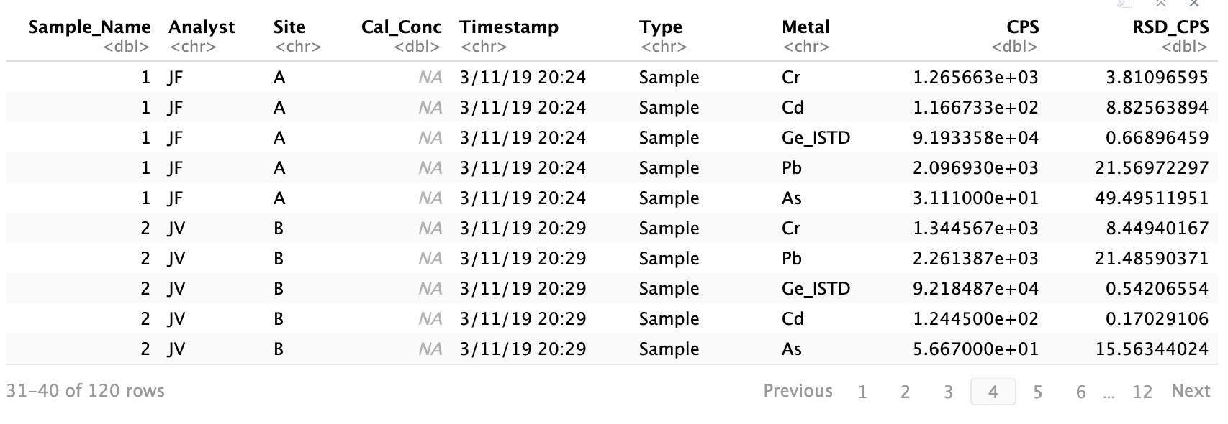
What is “Tidy Data”?
Notes:
This is what the ICPMS data looks like after tidying.

Slide 8
What is “Tidy Data”?
Notes:
With practice, using Tidy data helps to prevent error messages, and to make data analysis faster and more reproducible.

Slide 9
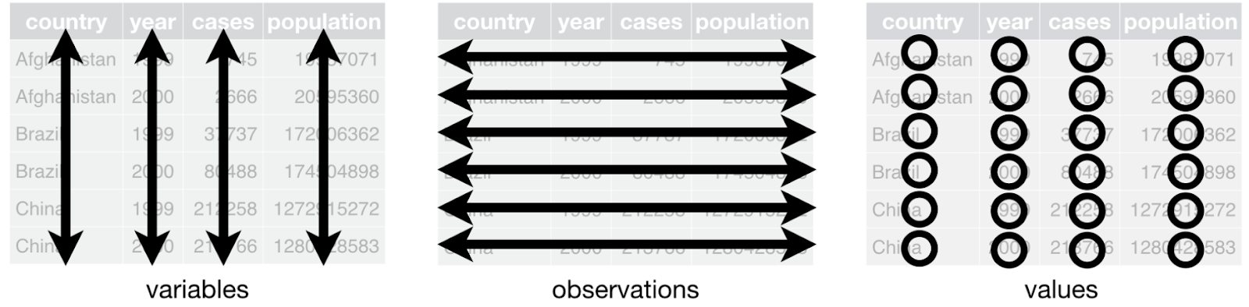
Rules for tidy data
source: https://r4ds.had.co.nz/tidy-data.html
Notes:
1. Each variable must have its own column.
2. Each observation must have its own row.
3. Each value must have its own cell.

Slide 10
Planning the Tidy Data: Limiting Columns
Limit # of variables
Combine variables by creating “new” variables that decrease the # of columns
Notes:
Limiting

Slide 11
Planning Tidy Data: Limiting Columns
Cr_SampleID, Cr_Site, Pb_SampleID, Pb_Site
vs.
Sample_ID, Site, Metal

Slide 12
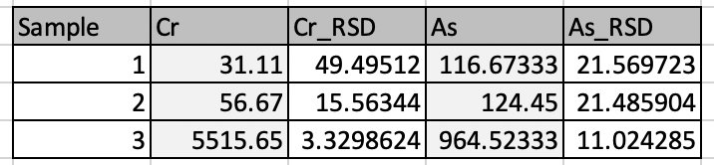
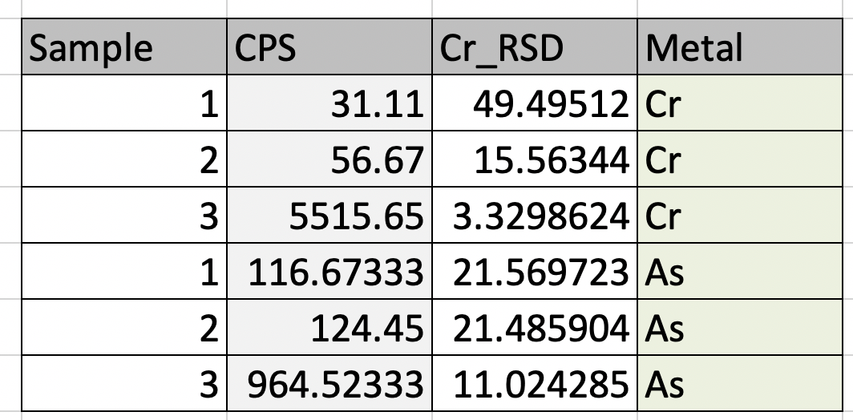
Horizontal vs. Vertical Data
Horizontal
Vertical

Slide 13
Horizontal vs. Vertical Data
Notes:
Tidied data moves away from the Horizontal data format and towards the vertical format. This allows you to efficiently use functions that filter the data to perform the data analysis!

Slide 14
Open the ICPMS Data in Excel
Notes:
This is what raw ICPMS data looks like, at this point if you all could download the zip file from model and open up each of the csv files in excel, that would be great! Opening up the data in excel allows you to see what format the data is currently in and what needs to be changed.

Slide 15
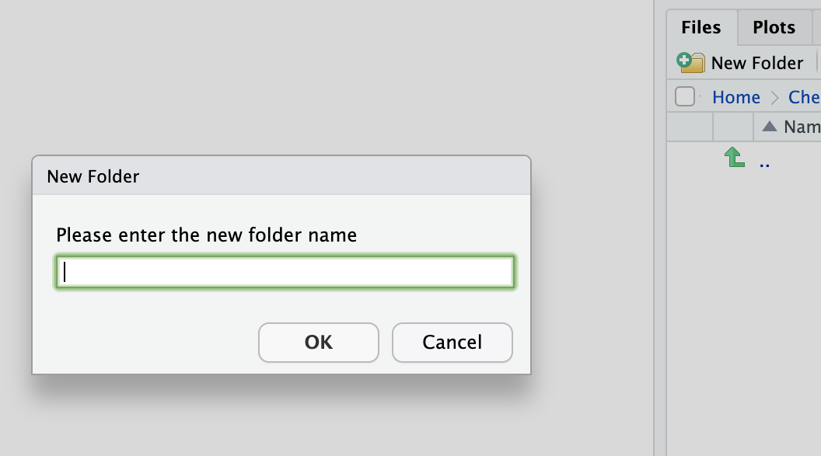
Prerequisites
1) Make a folder for this lab.
2) Upload the raw data
to the folder as a zip file.
3) Create and save an RMD file.
4) Load the following libraries:
tidyverse, readr.

Slide 16
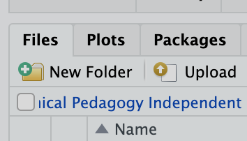
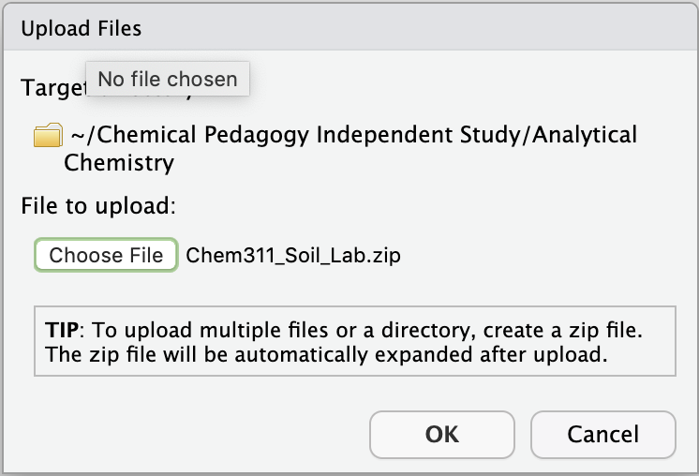
Prerequisites
1) Make a folder for this lab.
2) Upload the raw data
to the folder as a zip file.
3) Create and save an RMD file.
4) Load the following libraries:
tidyverse, readr.

Slide 17
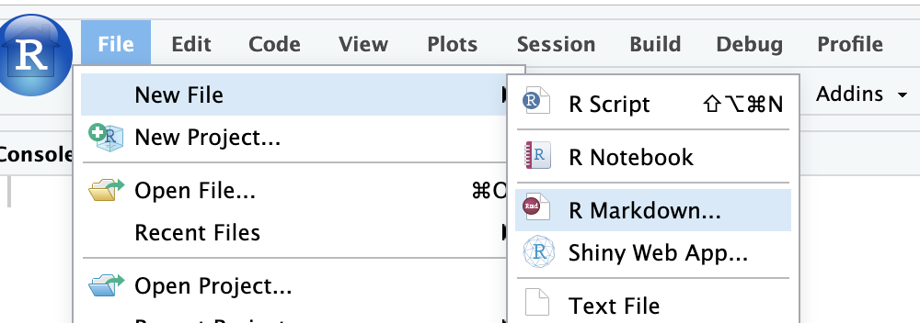
Prerequisites
1) Make a folder for this lab.
2) Upload the raw data
to the folder as a zip file.
3) Create and save an RMD file.
4) Load the following libraries:
tidyverse, readr.

Slide 18
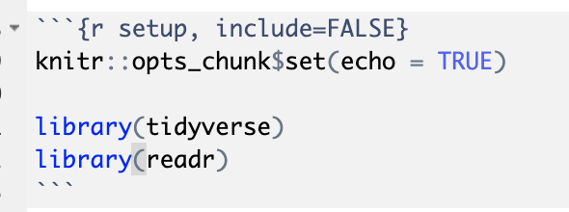
Prerequisites
1) Make a folder for this lab.
2) Upload the raw data
to the folder as a zip file.
3) Create and save an RMD file.
4) Load the following libraries:
tidyverse, readr.

Slide 19
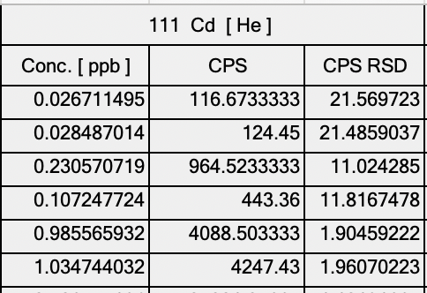
Importing the data
Data <- readr(“data.csv”, skip= 1)
Notes:
First we will import the data from the csv file, this can be done with the readr function. We set skip = 1 because the OHSU columns have two rows of headers, this will get rid of the first row of headers and set the second row as the column names which we can then call in future code. R will automatically rename columns with the same header by adding a number to the end of them. Later in the process we will change the column names to reflect the

Slide 20
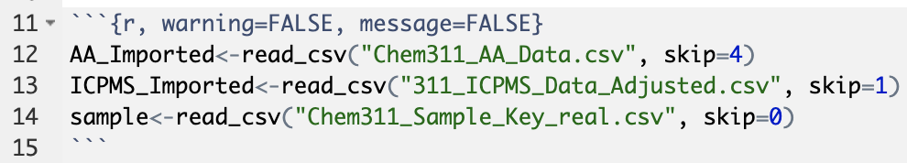
Importing the data
Notes:
Since the data is directly from the instrument there are a lot of problems with it: such as empty columns, repeated column names, etc. Setting warning=FALSE, and message=FALSE tells R gets rid of the warning messages. I would recommend running the chunk without these headers equal to FALSE first so you get an idea of what is wrong with the data format and then rerunning the chunk with them set to FALSE to get rid of the messages. Make sure to include the correct values for skip, based off off how many rows are in the excel file before the header row. Please raise your hand if you have any issues with this step.

Slide 21
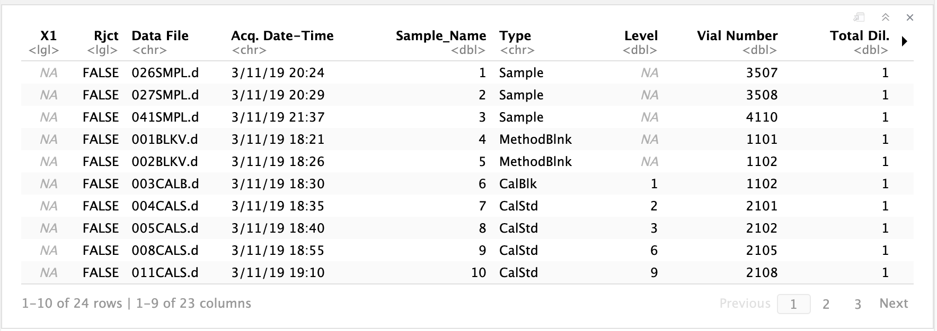
Importing the data
Notes:
This is what the data should (roughly) look like at this point. I recommend clicking through the columns and rows to get an idea of how R interpreted the data.

Slide 22
Identify key tidying steps:
Renaming the columns
Horizontal Data - > Vertical Data
Selecting the relevant columns
Merging the sample key and the data

Slide 23
Tidying RSD Data
1) Rename the RSD columns to reflect the metal
2) Select only the RSD columns
3) Gather the RSD columns into one column
4) Create a column that indicates which metal the RSD refers to

Slide 24
Tidyverse syntax: The pipe %>%
Data %>%
function(input)
Or
function( data = Data, input)

Slide 25
Tidyverse syntax: The pipe %>%
Data %>%
function(input)
Or
function( data = Data, input)

Slide 26
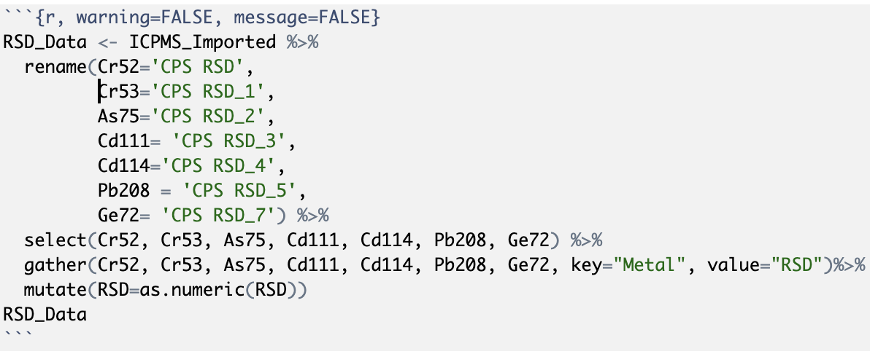
Tidying RSD Data: Calling the Data

Slide 27
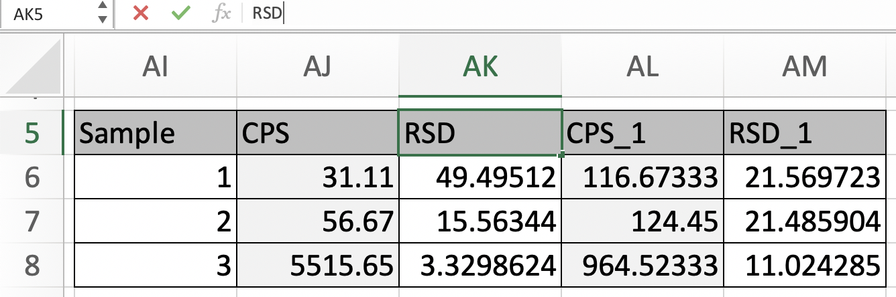
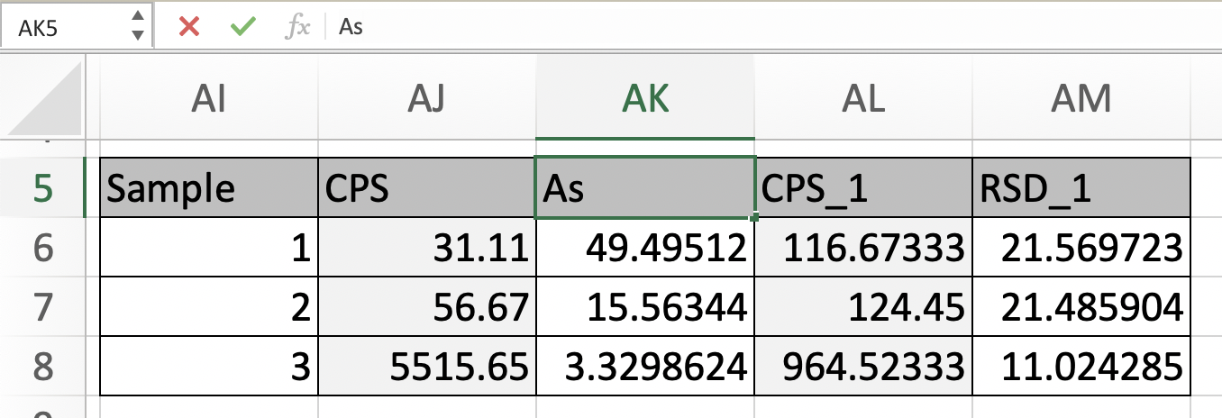
Tidyverse function: rename()
rename(new = ‘old 1’, new_2 = old_2)

Slide 28
Tidying RSD Data: Renaming Columns
Notes:
Note= order of columns being renamed doesn’t matter, but the matching of RSD to the correct metal does!

Slide 29
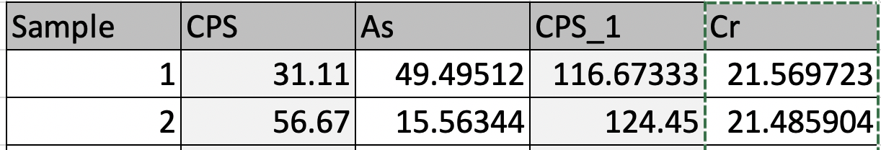
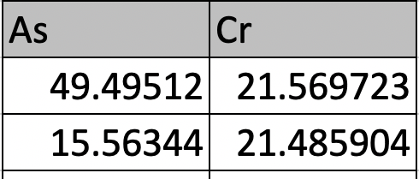
Tidyverse function: select()
select(Column1, Column2)

Slide 30
Tidying RSD Data: Selecting RSD Data

Slide 31
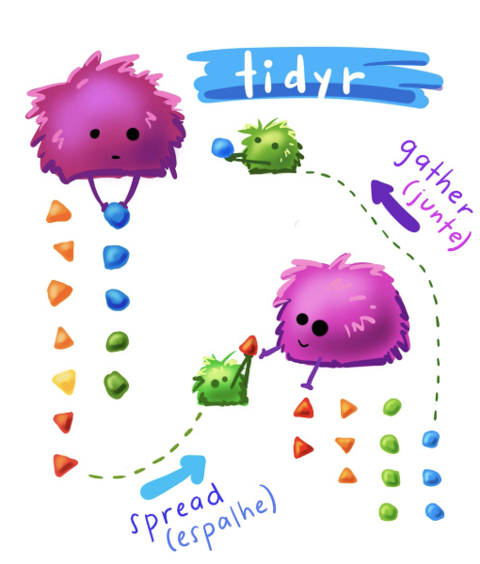
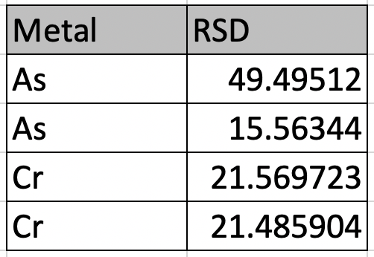
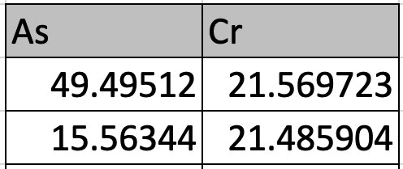
Tidyverse function: gather()
gather( As, Cr, key= “Metal”, value= “RSD")
Notes:
Gather() combines columns, and creates a column that keeps track of what the original columns were labeled, key indicates the name of the new column which contains the original labels, and value indicates the name of the original column values.

Slide 32
Tidying RSD Data: Gathering the RSD Data

Slide 33
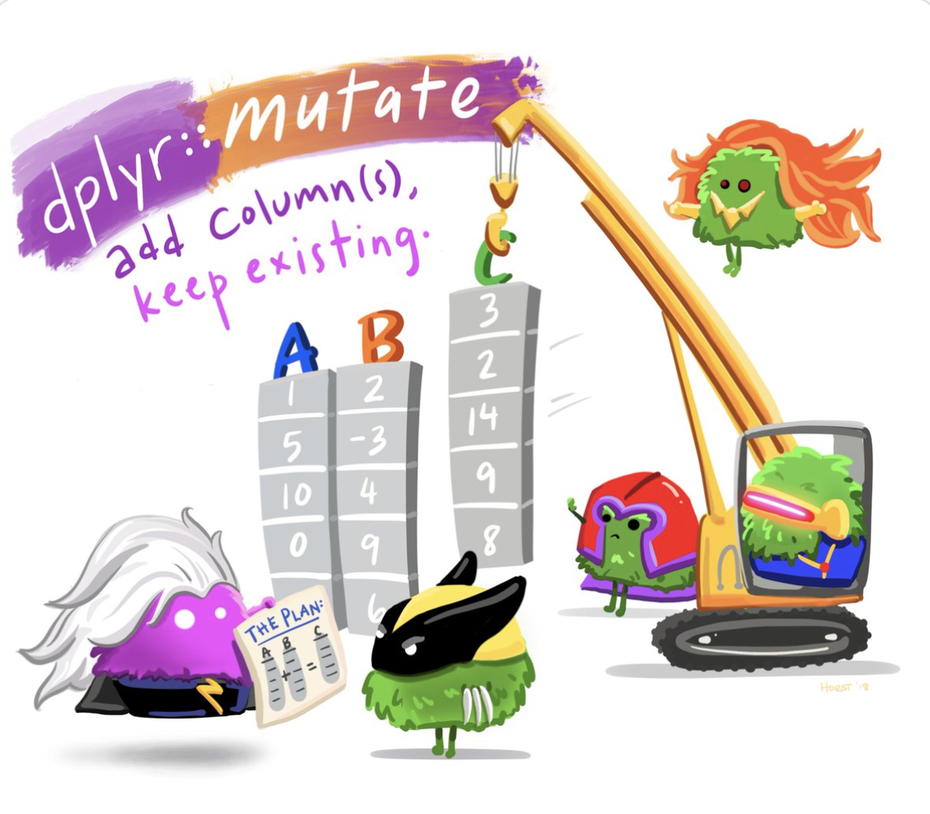
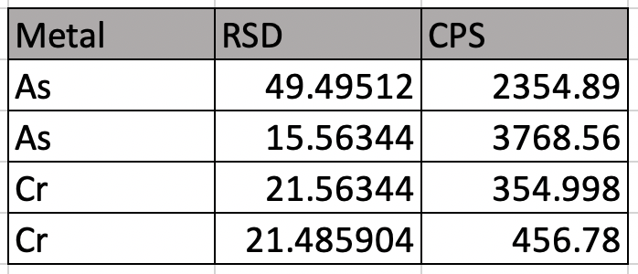
Tidyverse function: mutate()
mutate( new_column= new data)
Notes:
Mutate allows you to add in a new column to a pre-existing data frame

Slide 34
Tidying RSD Data: Mutating the RSD Data
Notes:
Add in a mutate function to change the pre-existing RSD column to numeric variables using the as.numeric() function.

Slide 35
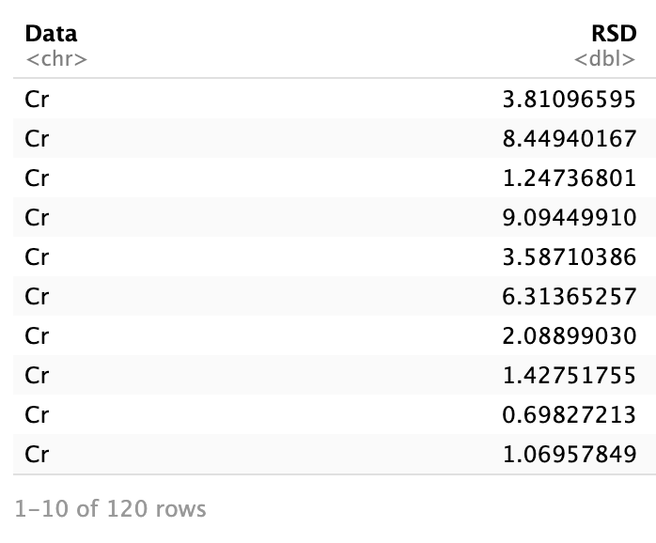
Tidy RSD Data
Notes:
This is ideally what the RSD data should look like at this point. By separating it into it’s own column and indicating which metal corresponds to which value we are able to insure that the RSD values correctly correspond to the CPS values. The code could be made more complicated to also indicate which sample each of these values correspond too but for now this should be enough.

Slide 36
Tidying the ICPMS Data
Rename CPS columns
Gather CPS data
Select relevant columns
Mutate, to add back in RSD data
Notes:
Next, we will tidy the rest of the ICPMS data by renaming the CPS columns, gathering the CPS values and selecting the relevant columns, and using a new function called mutate to add in the RSD data.
We can also use a relational operator to test whether the RSD values have been correctly matched to the right CPS value, this is not a necessary step but is a good way to insure that the code is doing what you think it is.

Slide 37
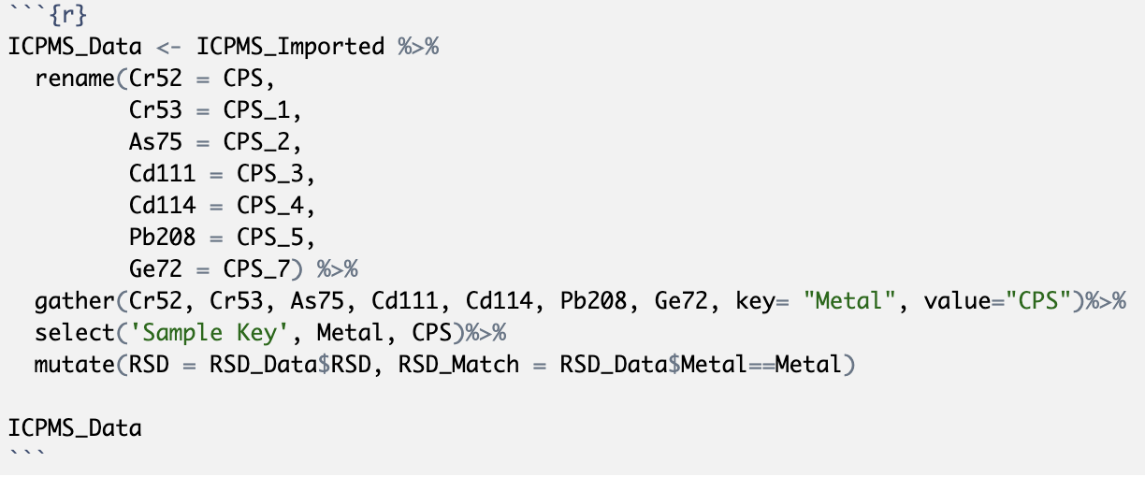
Rename CPS columns:

Slide 38
Gather CPS columns:

Slide 39
Select relevant columns:

Slide 40
Mutate in the RSD Data:

Slide 41
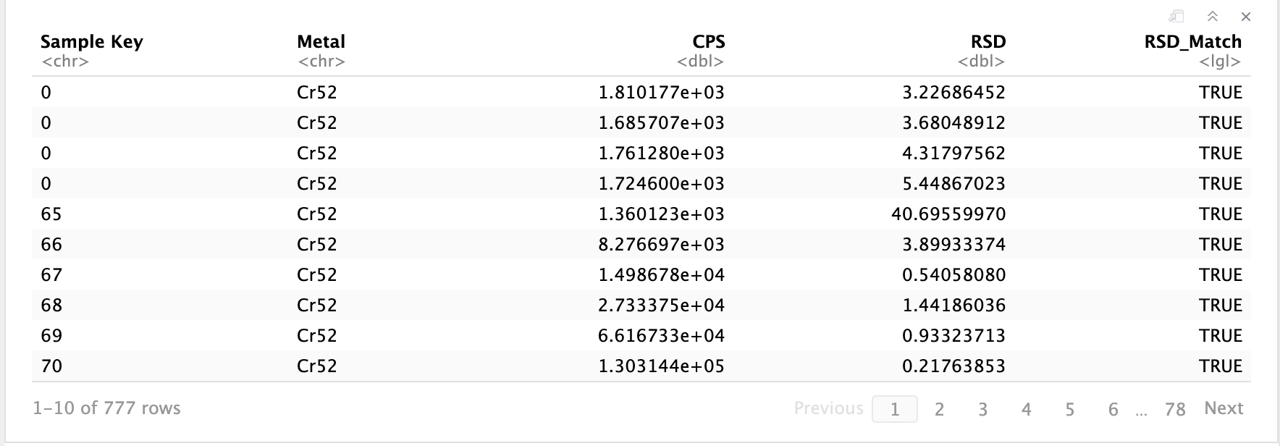
ICPMS Data

Slide 42
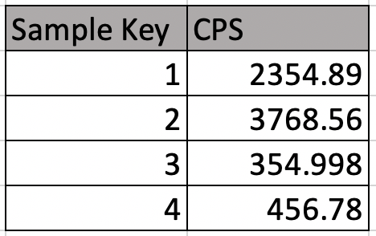
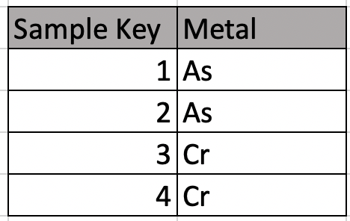
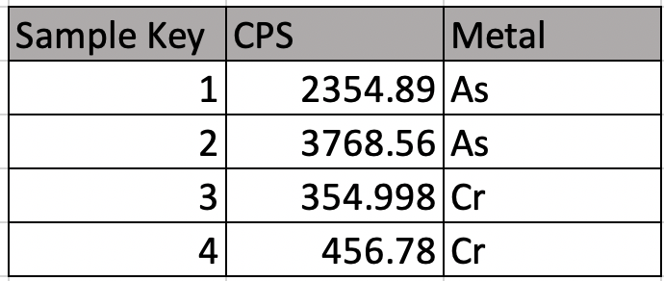
Tidyverse function: merge()
merge(data1, data2)
Notes:
Merge allows you to combine two dataframes that have an overlapping column, in our case the overlapping column in the sample key which is the number you have been using to label your samples.

Slide 43
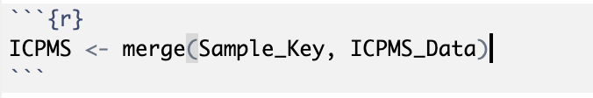
Merging in the Sample Key

Slide 44
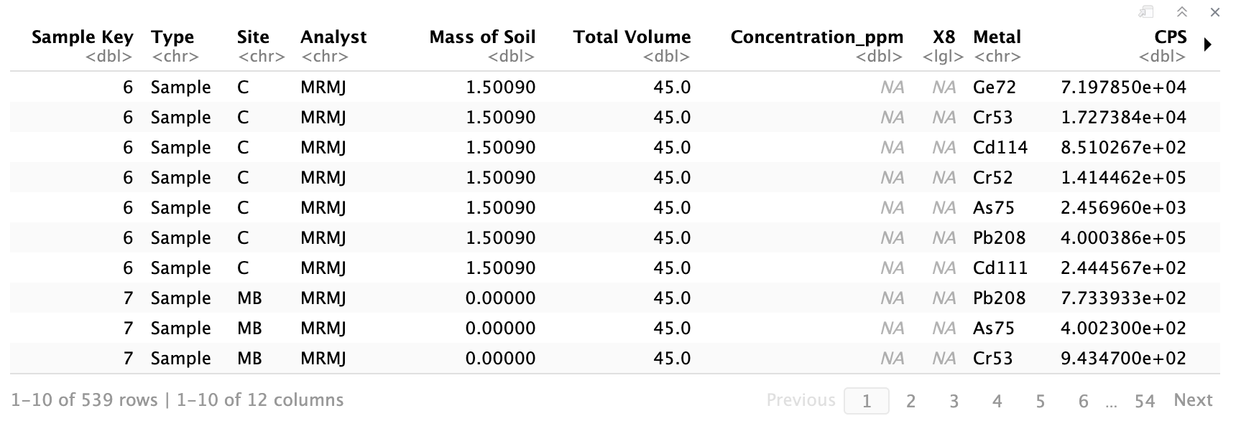
ICPMS Data

Slide 45
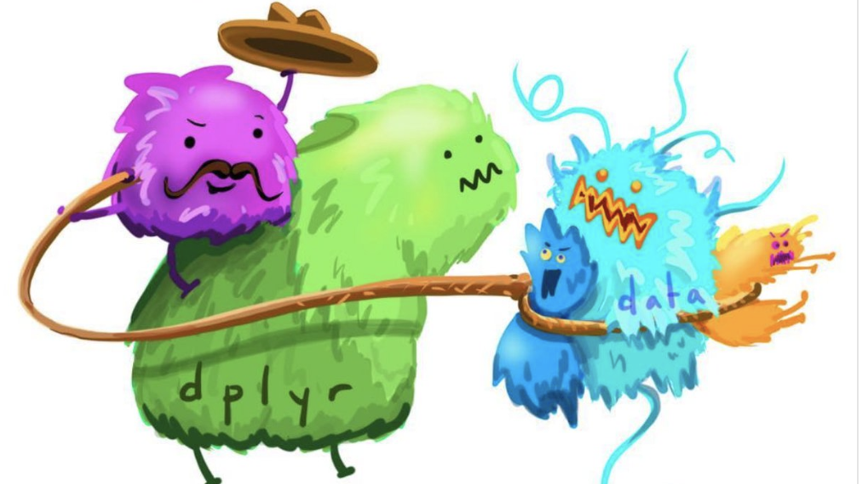
USING TIDY DATA
Notes:
Image credit: https://twitter.com/allison_horst/media

Slide 46
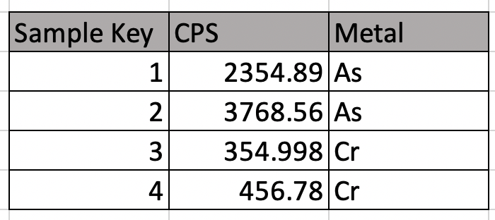
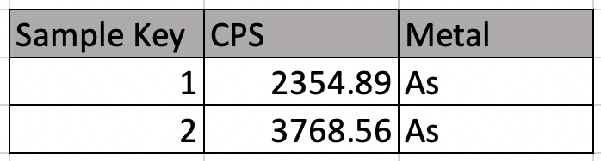
Tidyverse function: filter()
filter(column= “value”)
Notes:
Filter allows you to separate out data by a set variable, this is extremely useful when analyzing data since it allows us to specify which metal we are analyzing and which site to analyze.

Slide 47
Relational Operators: ==
Is value EQUAL TO value
Value == Value TRUE
Value == Not_Value FALSE

Slide 48
Relational Operators: !=
Is value NOT EQUAL TO value
Value != Value FALSE
Value != Not_Value TRUE

Slide 49
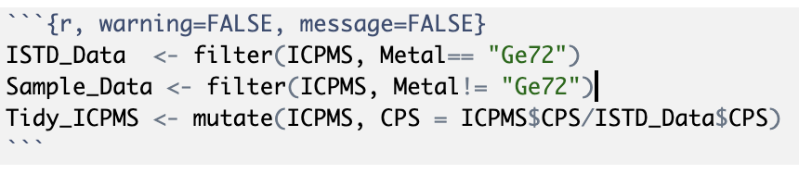
Using Tidy Data: Correcting for ISTD
Notes:
This is the code used to correct for the internal standard. Here, instead of using the pipe function the first term in mutate refers to the dataframe being mutated

Slide 50
Writing Functions

Slide 51
When to write a function?
When you copy/paste code three or more times

Slide 52
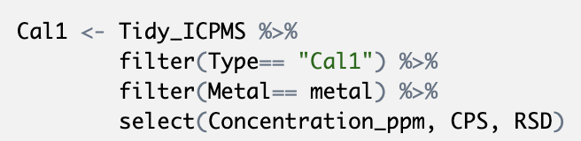
How to write a function: Step 1
Notes:
Start by writing code that you would normally copy paste multiple times, for example. Filtering out calibration data for each of the three calibration runs.

Slide 53
How to write a function: Step 2
Notes:
Next, Identify what would need to be changed between copying and pasting the code multiple times. In this case the aspect that needs to be changed is what calibration run “type” is set equal to

Slide 54
Function format:
Function <- function(input) {
Code
}

Slide 55
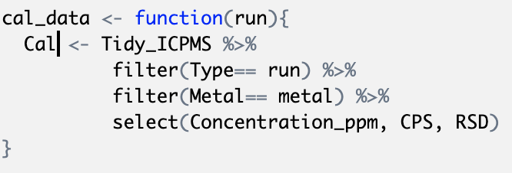
How to write a function: Step 3
Notes:
Next, pick a variable to replace the input. In this case we will use “run” which represents the calibration iteration.
metal is left as an undefined variable because this function is made to be incorporated in a

Slide 56
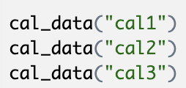
Running the function

Slide 57
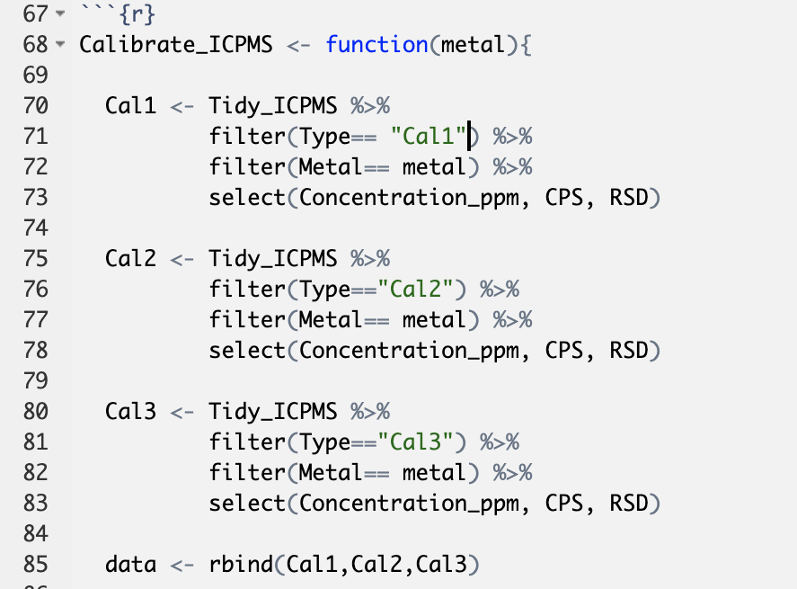
Analyzing ICPMS Data: Calibration function
Notes:
This portion starts the function and pulls out each of the calibration trials.

Slide 58
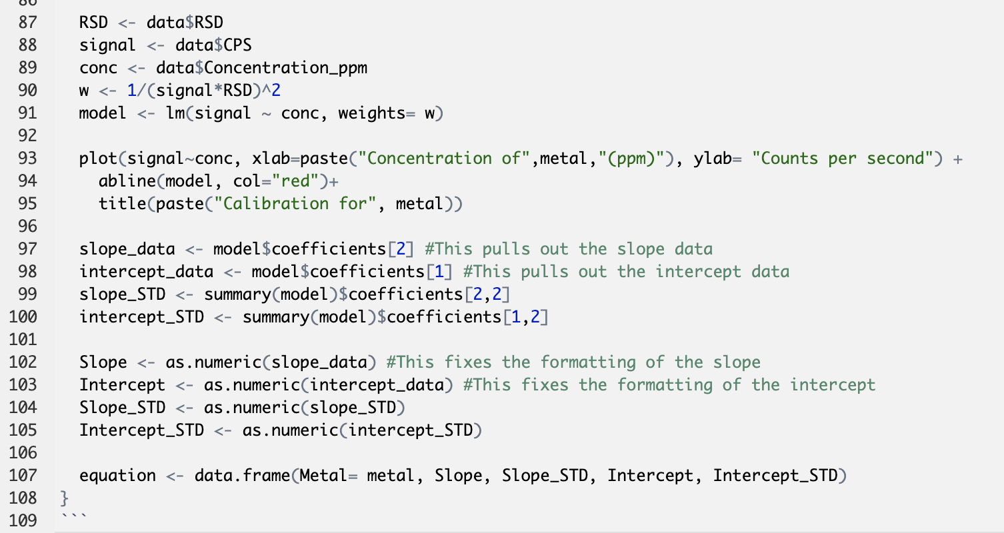
Analyzing ICPMS Data: Calibration
Notes:
This portion runs a weighted linear regression on the calibration data

Slide 59
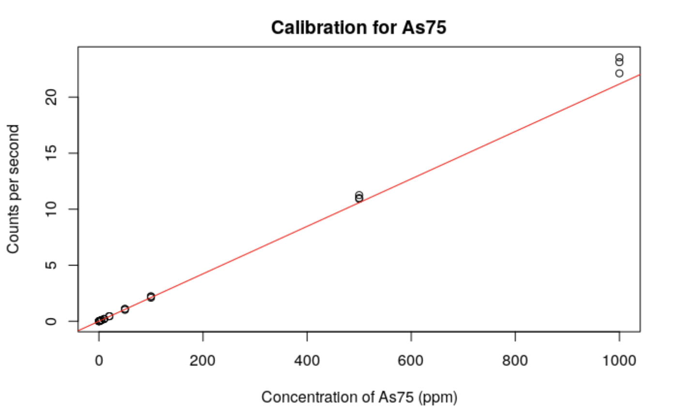
Analyzing ICPMS Data: Calibration
Notes:
This portion plots the calibration curve, by including this in the function it will automatically plot the data when the function is run, but it makes the captions a little odd in order to incorporate the correct metal into the labels. That is why the paste() function is used, for more information on the paste function run the command ?paste()

Slide 60
Analyzing ICPMS Data: Calibration
Notes:
This portion pulls out the slope and intercept data from the model summary. This is useful so that you don’t have to individually type in the slope and intercept values when calculating the sample concentrations. Note the curly bracket } that closes the function.

Slide 61
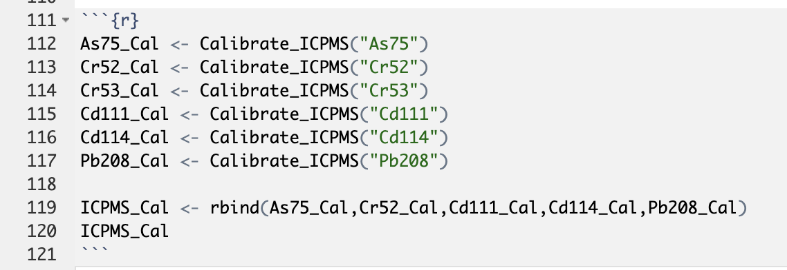
Analyzing ICPMS Data: Calibration
Notes:
We can now run the calibration function in order to analyze the cal data for each metal, and use a new function called rbind to combine the calibration data into one dataset, this step isn’t completely necessary but it does allow for more efficient code later on.

Slide 62
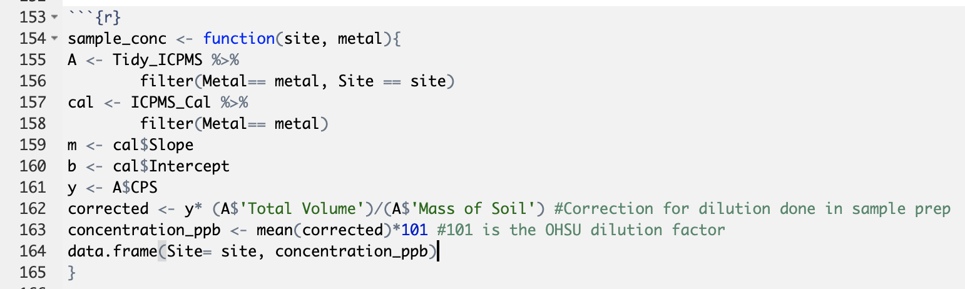
Analyzing ICPMS Data: Sample Concentration
Notes:
This function determines the sample concentration sorted by both site and metal. When calling the function make sure to set site equal to a character (i.e. something in quotation marks).

Slide 63
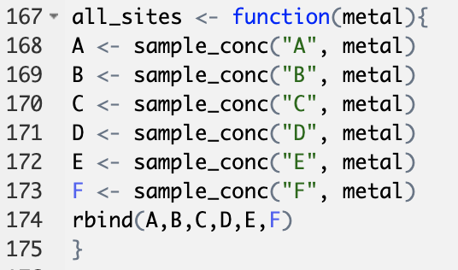
Analyzing ICPMS Data: Sample Concentration
Notes:
This new function calls upon a previous function (sample_conc) in order to further simplify the code.

Slide 64
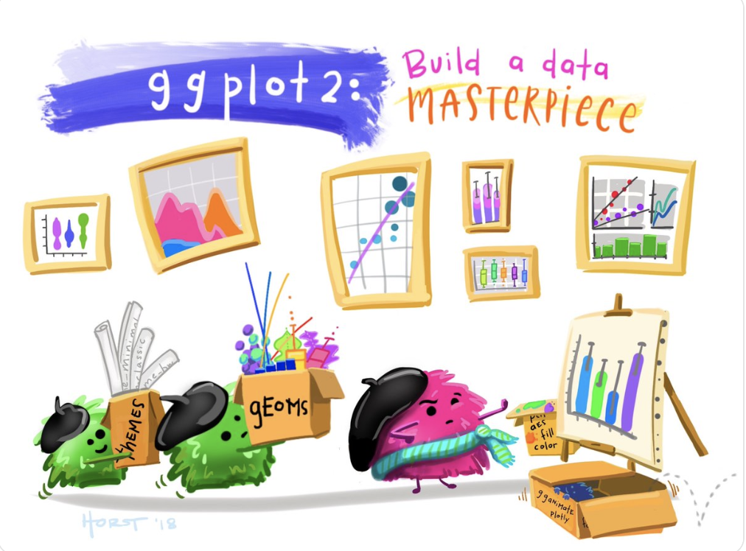
Next Steps:
Use similar code to analyze AA data:
Notes:
Only use a linear regression not a weighted linear regression
Plot all calibration data on the same plot
Use error propagation to determine the error of metal concentration.
Create data visualizations to represent the metal concentration data.
Notes:
Image credit: https://twitter.com/allison_horst/media

Slide 65

Notes:
Image credit: https://twitter.com/allison_horst/media

